Slide 1
Population aging: Intergenerational equity, gender, and the care economy
Ronald Lee
University of California at Berkeley, Demography and Economics
April 15 2021
Lecture Series on Carework and Intergenerational Justice (Online), University of Southern Denmark
Grateful to Gretchen Donehower from whose work I have borrowed, and to the NTA network

Slide 2
Preface
Many people sense that society is treating the young unfairly.
  Elderly now receive generous public pensions, health care and long-term care.
  These public programs are mostly unsustainable, will be less generous when the young grow old: higher taxes and lower benefits.
  Environmental concerns on top of economic ones.
I will not discuss the environmental topic.
I will focus on economic aspects of intergenerational equity and care-giving.

Slide 3
Two economic effects of population aging
Population aging means slower pop gr and more elderly relative to “working ages”.
  These changes affect total and per capita economic output (GDP) and wages and interest rates.
  Size of the economic pie and its primary distribution to individuals.
Population aging also affects the secondary distribution of income, which is passed on to children and the elderly who have little labor income and yet must consume.
  Families raise kids (food, housing, clothing etc.); grandparents may help or be helped
  Public sector taxes workers and asset holders and gives benefits to others
    public education for kids
    pensions for elderly
    health care mostly for elderly
This secondary redistribution is the main worry with population aging.

Slide 4
Talk has three parts, focuses on intergenerational equity and redistributions
Intergenerational equity and case of US.
The economic consequences of population aging
Taking caregiving into account.

Slide 5
1. Intergenerational equity

Slide 6
What is intergenerational equity?
Intergenerational fairness means that future patterns of support (public and private transfers) for children and the elderly are similar to those in place today. Keeping a “generational contract”.
In a world without change this would be possible and straightforward.
With economic growth “patterns of support” must be interpreted in proportion to rising income or lifetime earnings, not in fixed amounts.
For example, a pension would replace the same proportion of annual earnings in the future and the pension taxes or contributions should be the same proportion of earnings.

Slide 7
But there are other changes also disrupt the generational contract.
Population aging
  Life expectancy is rising.
  Fertility has fallen.
Changing economic life cycle: elderly consume relatively more and work less than before.
New public transfer programs are introduced, old ones are modified.
Returns to human capital have increased (educ wage differences).
Health care costs rise faster than productivity growth.

Slide 8
Low fertility disrupts generational contract in other ways, many of them good.
More education when fertility is low.
More time and attention from parents.
Inherit more wealth when parents’ assets are divided among fewer children.
Gets better jobs because fewer competitors.

Slide 9
But low fertility also brings costs to the smaller generations.
Fewer to support their parents and grandparents.
  Requires more personal care time from each grown child
  Requires paying higher taxes to support public programs for elderly.

Slide 10
Hard to say whether society treats young generations fairly.
Should the young be able to retire at the same age as their parents did?
  They will live 6 years longer than their parents; shouldn’t they also work longer?
  Perhaps the young should retire for the same proportion of their adult lives as their parents. Means working longer.
And the young have fewer children than their parents or grandparents, raising fewer working people to support them.
  Fairness requires they work even longer
Germany and Sweden have pension structures that work in this direction.

Slide 11
Here are key results from two papers that try to calculate what the young get
First paper focuses just on public sector, and compares what generations get over their lifetimes.
Second paper looks at newborn in 2010 and calculates what it gets from both public and family.s

Slide 12
Here we calculated what each generation gets over lifetime through main public programs, net of taxes
The Metric: Net Present Value (NPV) at birth of public benefits received minus taxes paid over lifetime
  Takes into account survival and discounting.
  Major project requiring many assumptions.
Antoine Bommier, Ronald Lee and Timothy Miller, Stephane Zuber (2010) “Who Wins and Who Loses? Public transfer accounts for US generations born 1850-2090,” Population and Development Review, 36:1, 1-26. PMCID: PMC2840408

Slide 13
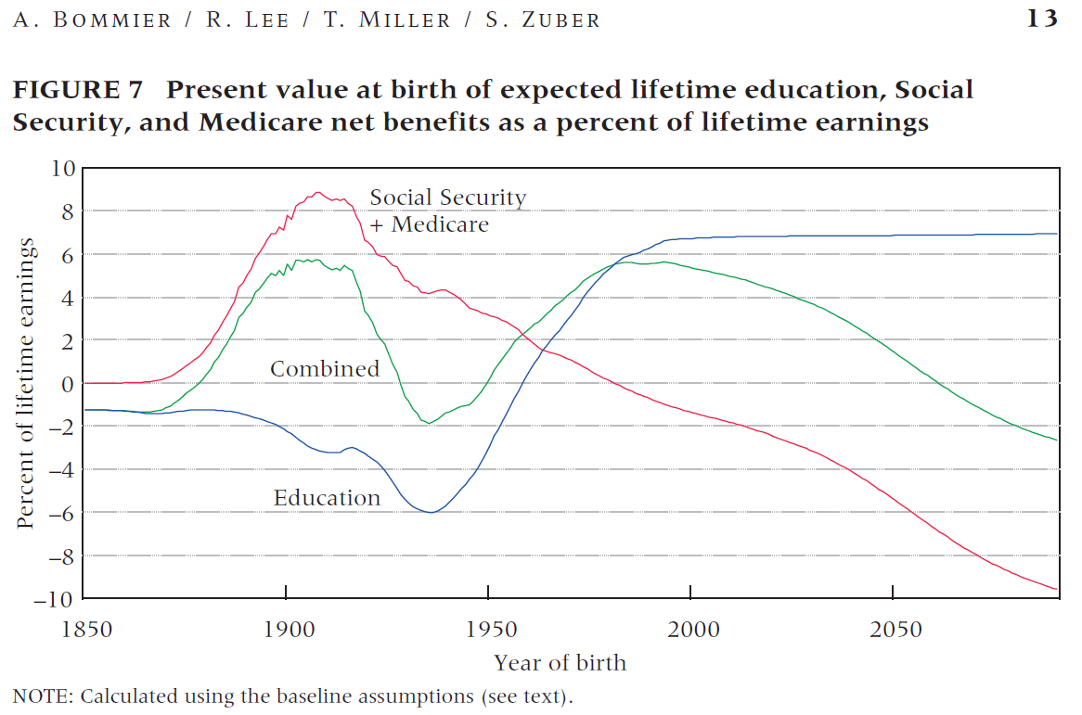
What generations born 1850 to 2050 get from the government:
Net present value of lifetime benefits minus taxes as a percent of lifetime earnings.
Children born 1950-2050 do well.
*They lose through pensions and health care for elderly
*They gain a lot from receiving public educ when young.
One dollar of old age benefits is worth eight dollars of benefits when young (survival and discounting at 3%/yr)
Old age programs are unsustainable. Projections assume that programs are balanced each year 50% by reducing benefits & 50% raising taxes.
Green=Total net benefit discounted to birth.
Children born from 1950 to 2050 do well.

Slide 14
Results are surprising
Today’s younger generations do well (born 1950 to 2050).
Today’s elderly born in the 1930s and ‘40s are slight losers.
Every generation born since 1950
  Loses through programs for the elderly,
  But gains more from rising public education.
  Big losers will be those generations born after 2050, who will do increasingly badly

Slide 15
Second study – public and family transfers
What does a newborn receive from earlier generations?
  Public transfers, including those in first study.
  Human capital.
  Social infrastructure.
  Assets inherited from parents, grandparents and others (bequests and inter vivos).
  Parental care and support (here material support only, not caregiving)
ALSO, but not counted here:
  Knowledge and technology.
  Culture and institutions
  The natural environment.
What will newborn give to future generations? Depends on:
  How many children are born and how they are raised
  Public policy and private behavior during the parents’ lifetime.

Slide 16
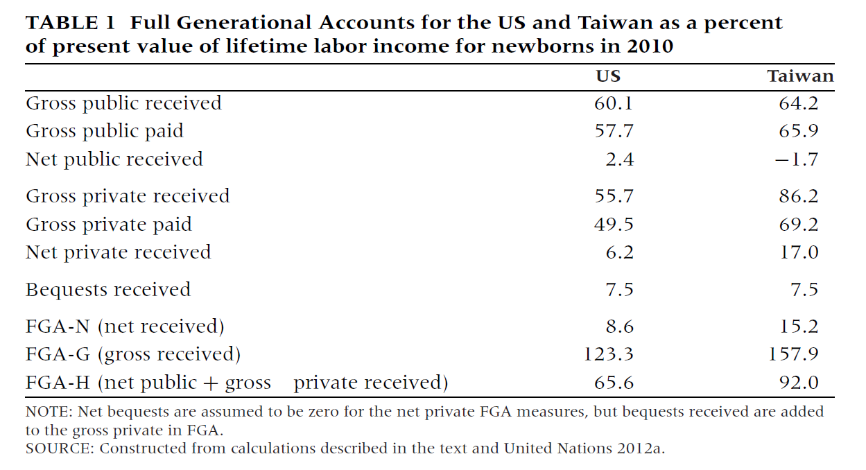
Gross, we give a lot, more than the Present Value of lifetime earnings.
Here is one attempt to count what newborns in 2010 will receive over their lifetimes in the US and Taiwan.
Ronald Lee, David McCarthy, James Sefton, and Jože Sambt (2017) “Full Generational Accounts: What do we give to the next generation?” Population and Development Review 43(4): 695–720.

Slide 17
Net it is much smaller.
Here is one attempt to count what newborns in 2010 will receive over their lifetimes in the US and Taiwan.
Ronald Lee, David McCarthy, James Sefton, and Jože Sambt (2017) “Full Generational Accounts: What do we give to the next generation?” Population and Development Review 43(4): 695–720.

Slide 18
Or perhaps it makes most sense to count net public plus gross private.
Here is one attempt to count what newborns in 2010 will receive over their lifetimes in the US and Taiwan.
Ronald Lee, David McCarthy, James Sefton, and Jože Sambt (2017) “Full Generational Accounts: What do we give to the next generation?” Population and Development Review 43(4): 695–720.

Slide 19
None of these counts the unpaid care work contributed by parents.
Here is one attempt to count what newborns in 2010 will receive over their lifetimes in the US and Taiwan.
Ronald Lee, David McCarthy, James Sefton, and Jože Sambt (2017) “Full Generational Accounts: What do we give to the next generation?” Population and Development Review 43(4): 695–720.

Slide 20
2. The economic life cycle, the economy and the support ratio
I use results from the National Transfer Accounts project (NTA), with thanks to all its country teams.
Definitions of measures
Labor income is wages and salaries plus 2/3 of self employment income, averaged across all individuals at a given age – males, females, and those with zero labor income.
Consumption is private household consumption imputed to individuals at each age in household, plus in-kind transfers from government received at each age (education, health care, etc.).

Slide 21
Source: Figure 1 in United Nations
Department of Economic and Social Affairs Population Division,
Technical Paper No. 2017/1
“Support Ratios and Demographic
Dividends: Estimates for the World”
Averages for 160 countries. NTA.
Standardized Labor Income by age; average for countries in income group (ratio to average labour income ages 30-49)
In High Inc countries…
Late start due to educ
Early retirement

Slide 22
Average per capita consumption by age for countries by income group
(expressed for each country as ratio to average labour income ages 30-49, 160 countries)
Source: Figure 2 in United Nations
Department of Economic and Social Affairs Population Division,
Technical Paper No. 2017/1
“Support Ratios and Demographic
Dividends: Estimates for the World”

Slide 23
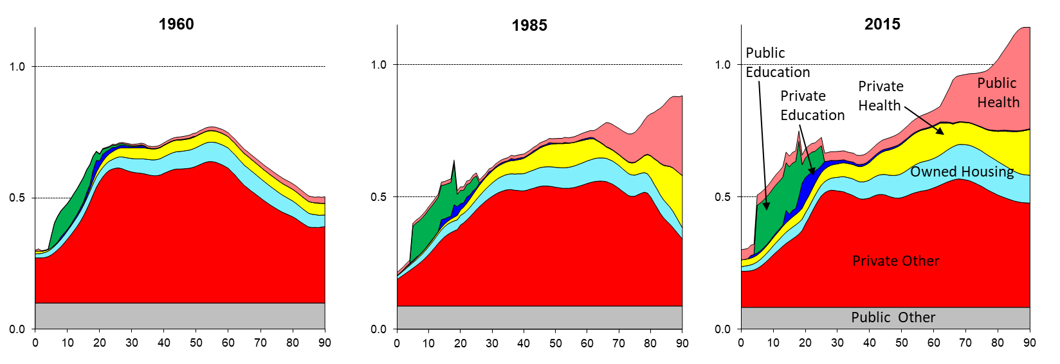
Changing age profile of consumption in the US over 55 years (cross-sectional NTA)
Y-axis scale: Relative to the (unweighted) profile average of labor income (YL) value for ages 30-49 for that year.
Source: Lee, Donehower&Miller (2011), updated

Slide 24
Support ratio is simplest way to see the economic effect pop aging and dependency
“Effective labor” is sum of NTA baseline labor income age profile times population age distribution.
Effective consumers and effective capital are defined in same way
These measures change with population size and age distribution.
“Support ratio” (SR) is effective labor/effective consumers.
For given productivity of labor, inc per effective consumer is proportional to SR.
“Demographic Dividend” = rate of change of Support Ratio (%/yr)

Slide 25
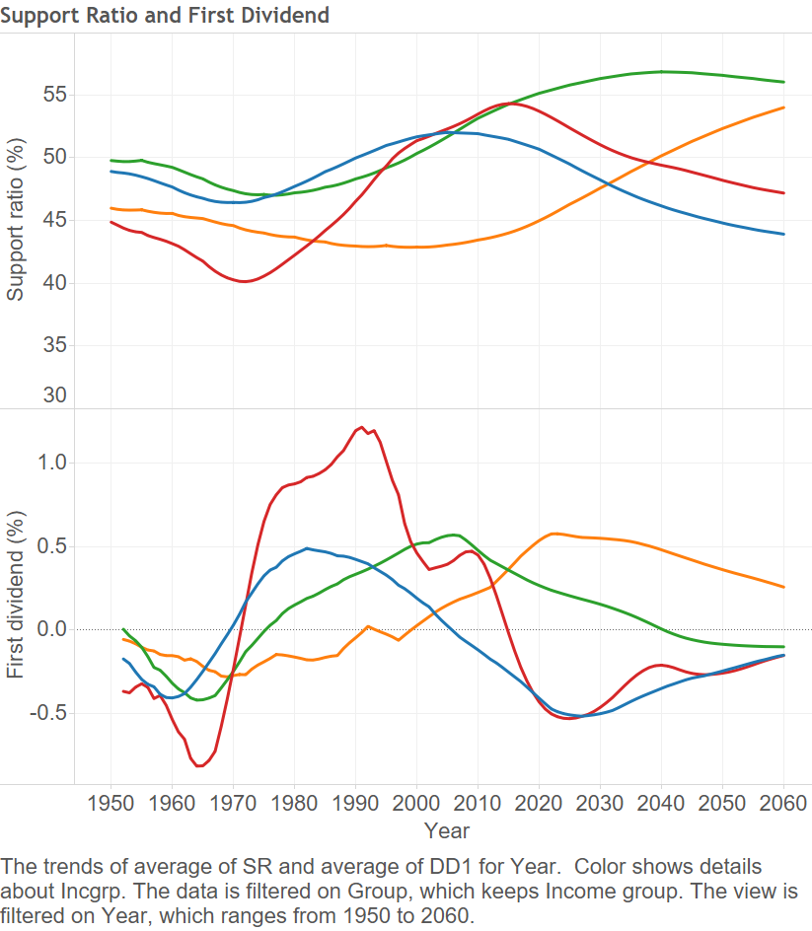
If pop in working ages grows faster than children and elderly, then support ratio rises.
Support Ratio of countries by income level groups
*Upper-Middle-Income countries gained over 1%/yr in cons growth, but only briefly.
*Lower and Low gain less, but over longer period
*High inc and Upper Middle are now rapidly aging, have negative dividend, losing .5%/yr
Support Ratio
Low-Mid Inc
Low-Inc
High Inc
Up-Mid Inc
Demog Div = change in Supp Rat
Up-Mid Inc
Low-Inc
Low-Mid Inc
High Inc

Slide 26
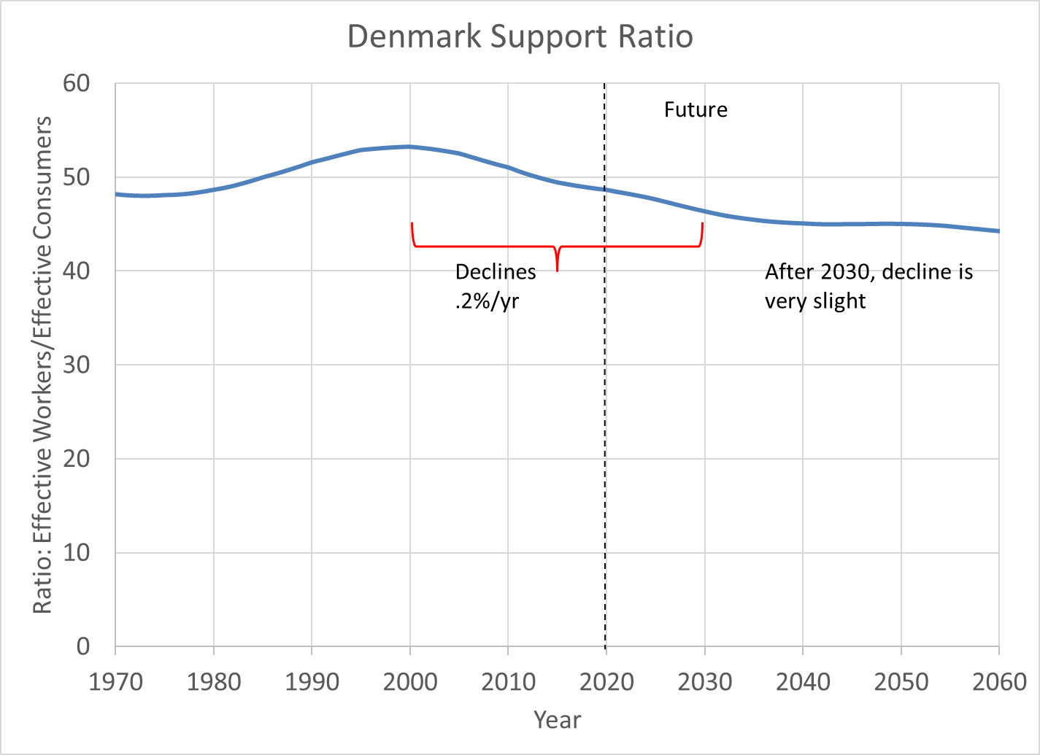
From 2000 to 2030, pop aging slows the growth of income per effective consumer by .2%/yr.
This is small cost of pop aging, not much to worry about.
Milder than for average High Income country.

Slide 27
3. But what about caregiving?
The age profiles of labor income and consumption on earlier slides only included paid work and market goods.
Now I will show results copied from: “Counting Women’s Work in an Aging World” by Gretchen Donehower and UC Berkeley, and members of the Counting Women’s Work research project and National Transfer Accounts research network (November, 2019)
Gretchen leads the international project, “Counting Women’s Work”, closely related to National Transfer Accounts (NTA). https://www.countingwomenswork.org/
Unpaid Care Work is UCW in following slides.

Slide 28
Women always spend much more time in UCS than men.
Some convergence at older ages.
Average amount of time spent in unpaid care work (UCW) by age and sex, hours per week.

Slide 29
Symmetry of age profiles means that men and women spend similar total time.
Men always spend much more time in market work.
Women always spend much more time in UCW.
Difference in average time spent by type of work, age, and sex, hours per week, male ‐ female.

Slide 30
If UCW is important economic production, we also have to consider the consumption of UCW.
Suppose a man prepares dinner for a family of four
  goes to the store to buy ingredients
  Cooks dinner
  Cleans up
Cost of dinner is the cost of ingredients and the cost of the time spent in all these tasks.
  The time costs are also consumed, not just the ingredients.
The man consumes ¼ of the full cost of the dinner.
The other ¾ of the costs are consumed by others in household.

Slide 31
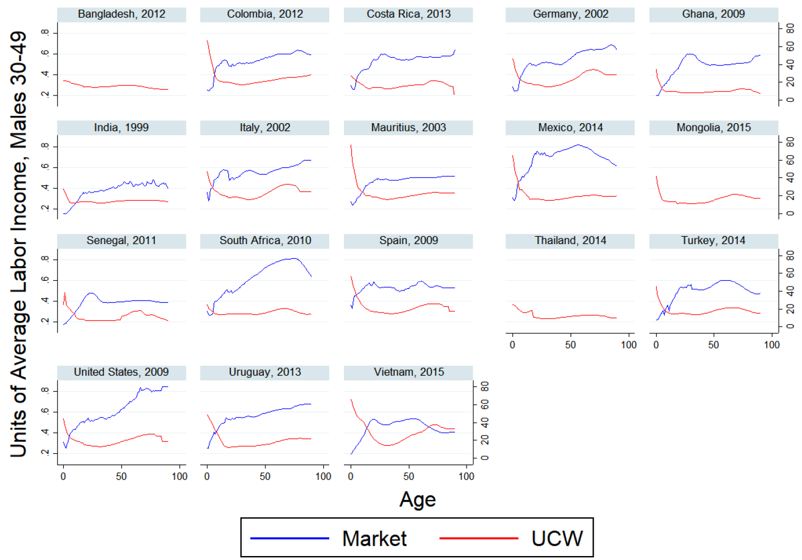
*Young children consume very little in market goods, but great deal of UCW.
*Elderly consume little UCW (except Vietnam).
*Ignoring UCW understates cost of children relative to elderly.
*That understates gains from reduced fertility overstates cost of pop aging.
Consumption of market goods and services compared to UCW time. Units of av male labor inc 30-49 for market goods. Units of hours per week for consumption of UCW.

Slide 32
Assigning economic value to UCW hours
There is no good way to do it.
We use one recommended method “replacement cost”:
value each UCW activity time by the hourly rate for hiring a market specialist to do that work: cooking, child care, elder care, nursing, cleaning etc.

Slide 33
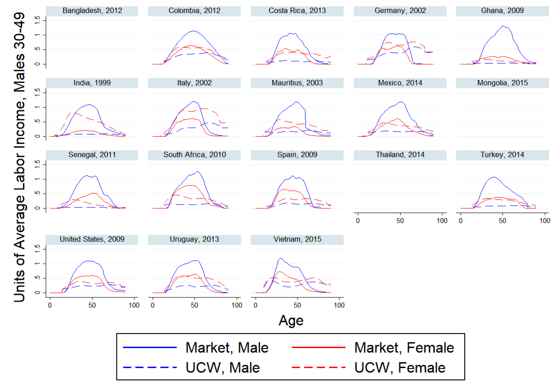
Market‐based labor income compared to UCW valued at replacement wage, by sex, (both as ratios to average male labor income age 30‐49). (Donehower, 2019)

Slide 34
Recalculate support ratios counting cost of UCW in both production and consumption

Slide 35
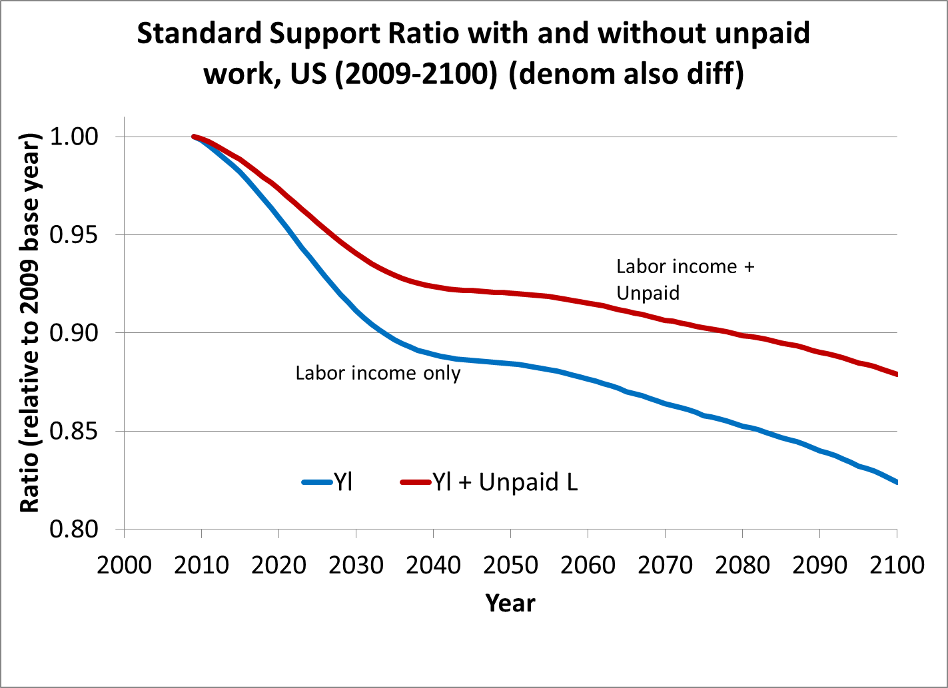
2009-2050 declines .3%/yr for standard support ratio
Only .2%/yr with time costs counted.

Slide 36
Literature cited
Bommier, Antoine, Ronald Lee and Timothy Miller, Stephane Zuber (2010) “Who Wins and Who Loses? Public transfer accounts for US generations born 1850-2090, Population and Development Review, 36:1, 1-26. PMCID: PMC2840408
Lee, R. and G. Donehower (2011) “Private transfers in comparative perspective” Chapter 8 in R. Lee and A. Mason (eds.), Population Aging and the Generational Economy: A Global Perspective. Edward Elgar. (viewable on the IDRC website http://www.idrc.ca/EN/Resources/Publications/Pages/IDRCBookDetails.aspx?PublicationID=987
Lee, R., G. Donehower, and T. Miller (2011) “The changing shape of the economic lifecycle in the United States, 1970 to 2003” Chapter 15 in R. Lee and A. Mason (eds.), Population Aging and the Generational Economy: A Global Perspective. Edward Elgar. (viewable on the IDRC website http://www.idrc.ca/EN/Resources/Publications/Pages/IDRCBookDetails.aspx?PublicationID=987
Lee, Ronald (2019) “Population aging and systems of intergenerational transfers” in Population Histories in Context: Past achievements and future directions. Celebrating the 50th anniversary of the founding of the Cambridge Group for the History of Population and Social Structure.
Gretchen Donehower and members of the Counting Women’s Work research project (2019) “Counting Women’s Work in an Aging World” Working Paper of Counting Women’s Work.
Ronald Lee, David McCarthy, James Sefton, and Jože Sambt (2017) “Full Generational Accounts: What do we give to the next generation?” Population and Development Review 43(4): 695–720.
Andrew Mason, Ronald Lee, Michael Abrigo, and Sang-Hyop Lee (2017) “Support Ratios and Demographic Dividends: Estimates for the World” Technical Paper, Population Division of the Department of Economic and Social Affairs, United Nations, www.unpopulation.org.
NTAccounts.org

